Slide 1
Mental Health
CRISIS
COVID 19
WHAT HEALTH CARING PROFESSIONALS
NEED TO KNOW

Slide 2
PANDEMICS - HISTORICAL
430 B.C.: Athens – form of typhoid fever killing 2/3 of the population
165 A.D.: Antonine Plague – small pox, began with the Huns continued throughout Germany & Rome until 180 A.D.
250 A.D.: Cyprian Plague – spread throughout Northern African, Rome, Egypt and north - entailed diarrhea, vomiting, throat ulcers, fever and gangrenous hands and feet
541 A.D.: Justinian Plague – bubonic plague spread through Egypt, Palestine, Byzantine Empire, Mediterranean; over the next two centauries, would kill about 26% of the world population (50 million).
11th Century: Leprosy - Now known as Hansen’s disease, it still afflicts tens of thousands of people a year and can be fatal if not treated with antibiotics.
1350: The Black Death Responsible for the death of one-third of the world population
1492: The Columbian Exchange - smallpox, measles and bubonic plague were passed along to the native populations by the Europeans. With no previous exposure, these diseases devastated indigenous people, with as many as 90 percent dying throughout the north and south continents (56 million Native Americans in the 16th and 17th centuries)

Slide 3
PANDEMICS – HISTORICAL
1665: The Great Plague of London - 20 percent of London’s population died
1817: First Cholera Pandemic small intestine infection originated in Russia, where one million people died
1855: The Third Plague Pandemic – China, India, Hong Kong claimed 15 million
1875: Fiji Measles Pandemic claimed 1/3 of the population
1889: Russian Flu By the end of 1890, 360,000 had died.
1918: Spanish Flu - The avian-borne flu that resulted in 50 million deaths worldwide
1957: Asian flu – started in Hong Kong - six months, 14,000 people died. A second wave followed in early 1958, causing an estimated total of about 1.1 million deaths globally, with 116,000 deaths in the United States alone
1981: HIV/AIDS 35 million people worldwide have died of AIDS since its discovery, and a cure is yet to be found.
2003: SARS believed to have possibly started with bats, spread to cats and then to humans in China, followed by 26 other countries, infecting 8,096 people, with 774 deaths.
2019: COVID19: December 31, 2019 – Wuhan Municipal Health Commission began to report cases of a “viral pneumonia”

Slide 4
PANDEMICS – Historical Political/Social Implications
Travel between regions increased wide-spread risks to infections (by 1520, Aztec population was annihilated).
Country/Region experienced increase risk to invasion (many of the historical pandemics occurred during wars; Athenians (Peloponnesian War) lost to Sparta as a result of weakened armed forces).
Political Power redistributed within regions/countries (During the Black Plague, British feudal system collapsed when the plague changed economic circumstances and demographics)
Social and Economic structures collapsed (Justinian plague caused a massive economic collapse. The apocalyptic aftermath aided the spread of Christianity).
Recent evidence concludes the deaths of some 56 million Native Americans in the 16th and 17th centuries, largely through disease, may have altered Earth’s climate (vegetation growth on previously tilled land drew more CO2 from the atmosphere and caused a cooling event)

Slide 5
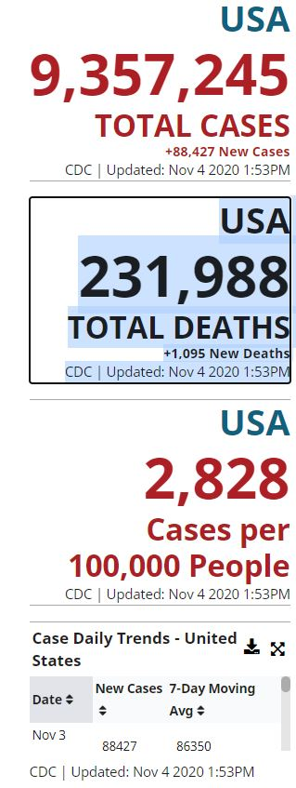
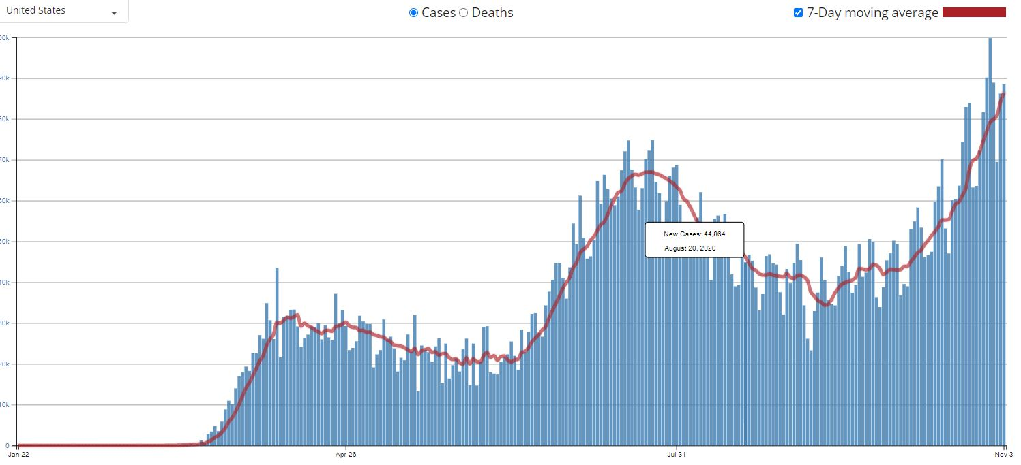
COVID19 - 2019
CDC CURRENT STATS
AUGUST 2020 – 0VER 40K NEW CASES IN ONE DAY

Slide 6
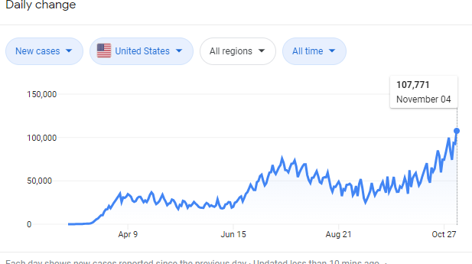
CURRENT COVID STATISTICS
CDC CURRENT STATS
BY NOVEMBER 2020 107, 771 NEW CASES IN ONE DAY

Slide 7
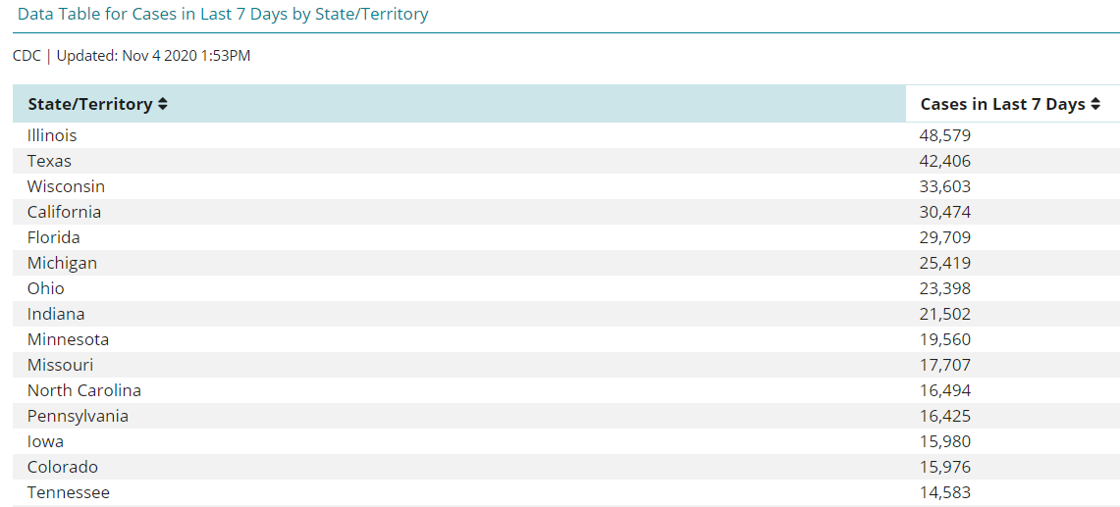
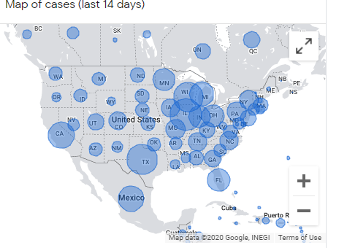
CURRENT COVID STATISTICS
CDC CURRENT STATS - CASES
BY STATE

Slide 8
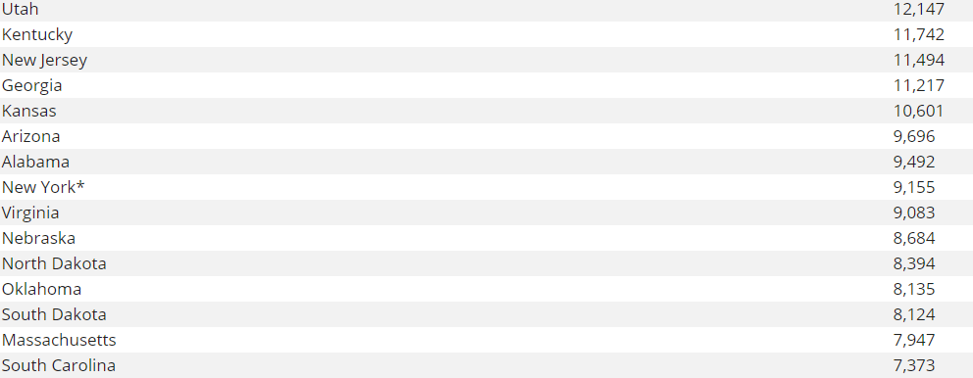
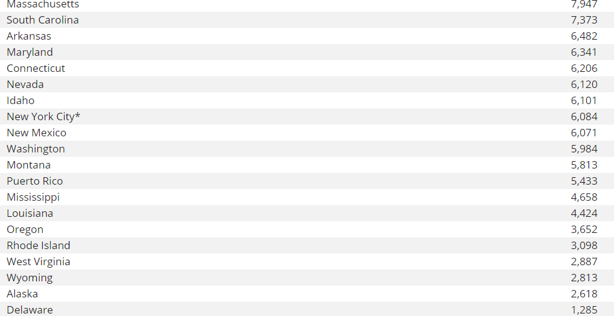
CURRENT COVID STATISTICS
CDC CURRENT STATS – CASES
As of 11/4/20
BY STATE

Slide 9
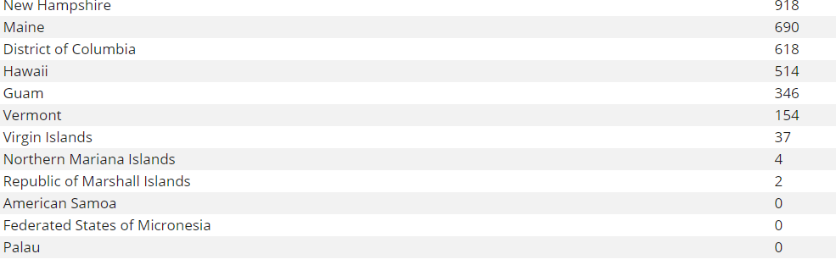
CURRENT COVID STATISTICS
CDC CURRENT STATS - CASES
BY STATE
As of 11/4/20

Slide 10
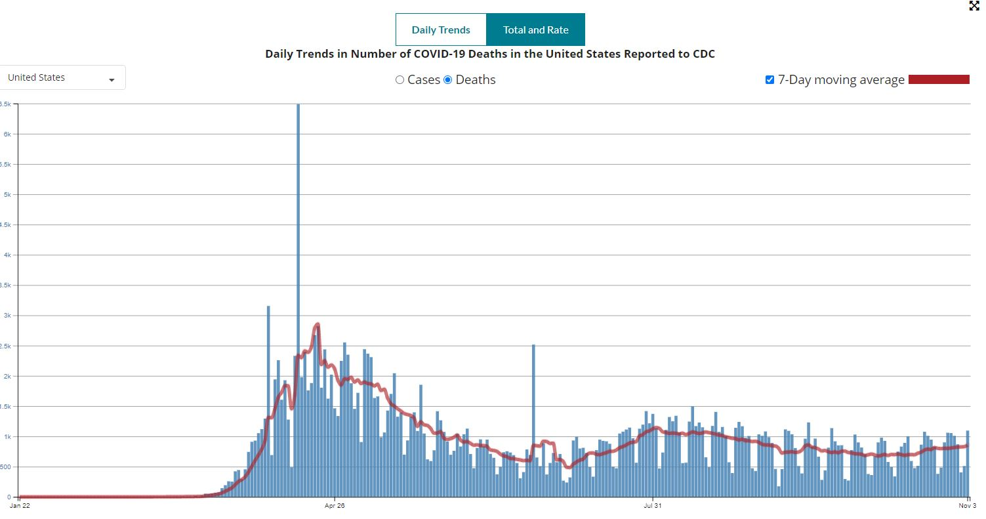
CURRENT COVID STATISTICS
CDC CURRENT STATS DEATHS 11/4/20
Males 117,553
Female 99,789

Slide 11
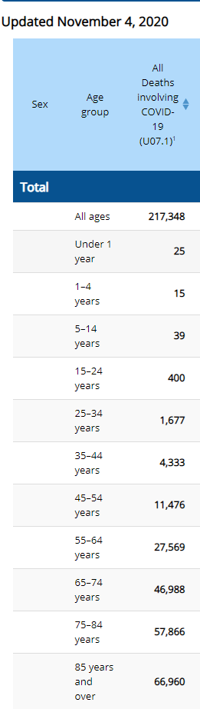
CURRENT COVID STATISTICS
CDC CURRENT STATS DEATHS 11/4/20

Slide 12
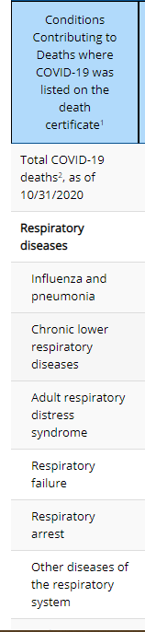
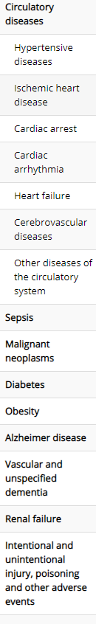
CURRENT COVID STATISTICS
CDC CURRENT STATS DEATHS

Slide 13
Covid 19 – Political/Social Implications
Social and Economic structures are collapsing
Political Power redistributing within regions/countries
Country/Region experiencing increase risk to outside invasion & civil unrest
Travel within regions/countries have increased wide-spread risks to infections
Racial/Ethnic Tensions in the United States overlay this current pandemic
Discrimination and racism, along with economic and environmental disparities, already reduce access to education, health care, and resources (example: Early COVID-19 rates in Michigan show that Black Americans make up 41% of deaths, while only making up 13% of the population)
The global response to the COVID-19 pandemic has led to a sudden reduction of both GHG emissions and air pollutantsits. While the COVID-19 pandemic has reduced air pollution in the United States, the longer-term impact on the environment is unclear.

Slide 14
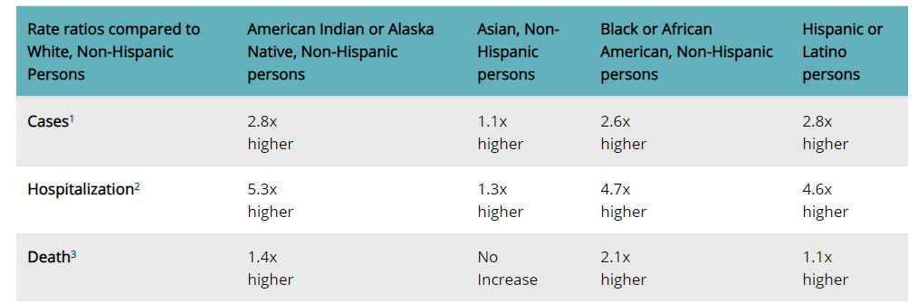
CURRENT COVID STATISTICS
CDC CURRENT STATS - Race
The COVID-19 economic crisis has severely impacted poorer people and those in more socially disadvantaged groups disproportionately harder.

Slide 15
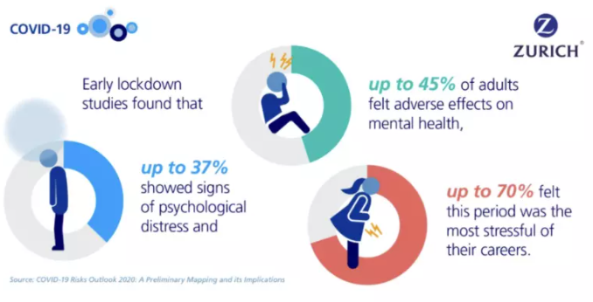
Covid 19 – Implications

Slide 16
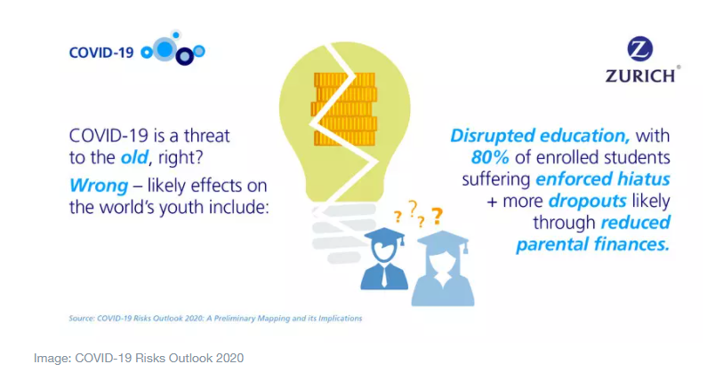
Covid 19 – Implications
Currently 80% of the world’s students - more than 1.6 billion young people - are not attending school. Many students in poorer communities lack the necessary tools to access online courses or face difficulties working at home. The consequences of these educational inequalities, especially for girls and young women, will disadvantage them in labour markets and further exacerbate inequality.

Slide 17
IMPLICATIONS FOR MENTAL HEALTH Professionals
“The Covid19 Pandemic is presenting unprecedented challenges for Mental Health professionals in the United States & worldwide. Talk about what some of the challenges are, immediate and long-term, for you as a Mental Health professional based on the presentation.”

Slide 18
Mental Health
CRISIS
COVID 19
WHAT HEALTH CARING PROFESSIONALS
NEED TO KNOW
Sheree Johnson, Ph.D., LPC, Director, Gestalt Counseling & Training Institute of Ann Arbor
www.a2gestalt.com

